Slide 1
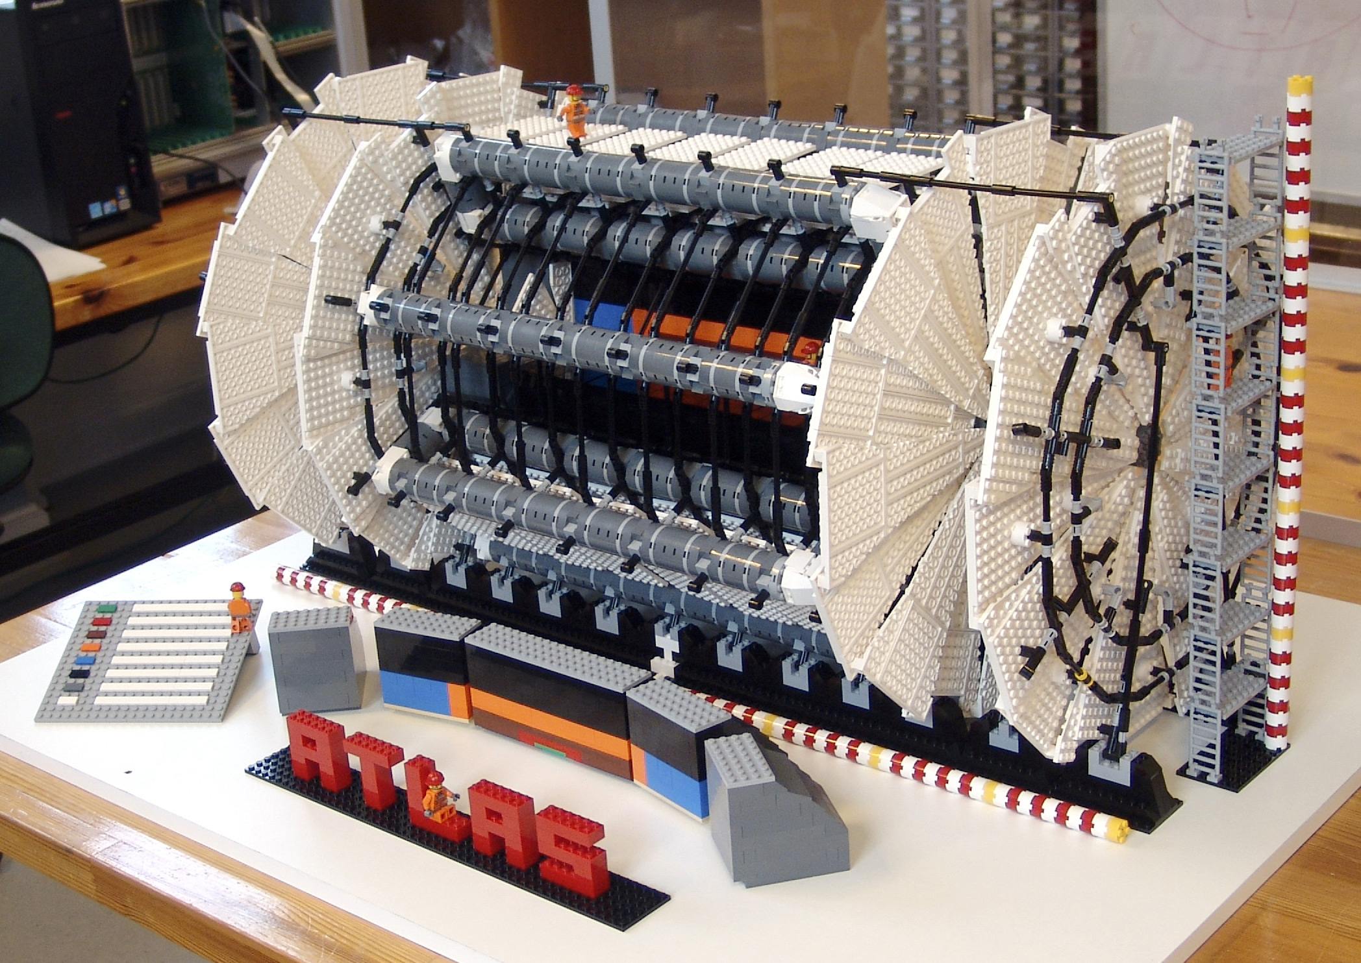
Эксперимент ATLAS
Научная сессия ученого совета ОФВЭ ПИЯФ
23-26 декабря 2013 года
Олег Федин

Slide 2
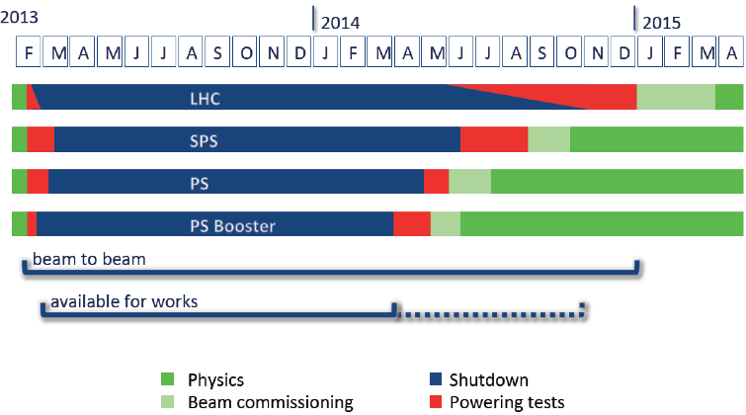
LHC shutdown LS1
LHC back for physics in April 2015 with most probably 13 TeV, i.e. 1.6 times enlarged energy
ATLAS LS1 activities:
repair and revision of all ATLAS sub-systems.
installation of the Pixel IBL.
Analysis of data accumulated during RUN-I.
Preparation for the ATLAS detector upgrade in Phase-I (2018).

Slide 3
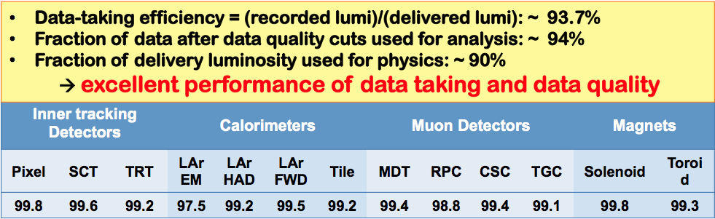
RUN-I: ATLAS Luminosity & Data taking
Outstanding performance of LHC !
2012 – 8 TeV
L ~ 23 fb⁻¹
Number of events in RUN-I dataset (~ 28 fb⁻¹) after all selection cuts:
W → lν ~ 100 M (LEP2: 0.2M pair W⁺/W⁻)
Z→ ll ~ 10 M (LEP 16M )
tt → l+X ~ 0.4 M
SM Higgs ~ 400
[~1 H→ γγ (~1 H→ 4l) produced every 50’ (14h)
at 7x 10³³ ]
2011 – 7 TeV
L ~ 5 fb⁻¹
ΔL/L = ±2.8 (preliminary)
2010 – 7 TeV
L ~ 0.05 fb⁻¹
ΔL/L = ±1.8
ΔL/L = ±3.4

Slide 4
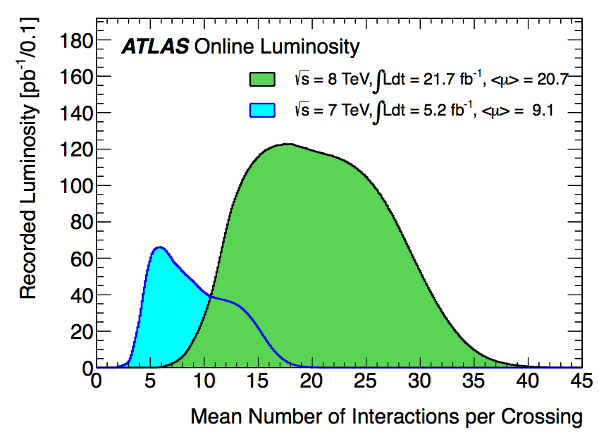
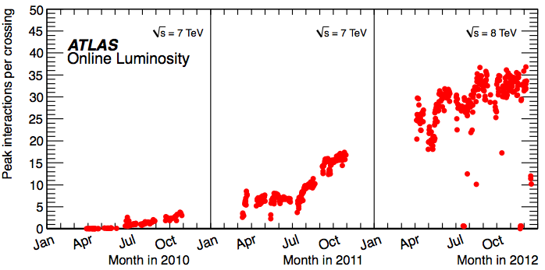

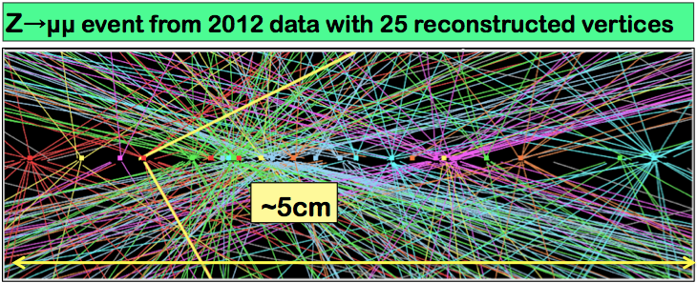
A challenge in RUN-I - pile up events
Numbers of interactions per bunch crossing
peak # collisions vs time
Huge efforts invested over the RUN-I to minimise the impact of pile-up on physics
Experiment’s design value ~22
Expected to be reached at L~10³⁴
2012
2011
Peak Luminosity: 7.73 x 10³³ cm⁻² s⁻¹
Strategy:
• Developed pile-up robust fast triggers;
• Optimized reconstruction and identification of physics objects;
• Precise modeling of in-time and out-of-time pile-up in simulation;
• Flexible computing model to handle x2 trigger rate and x2 event size.

Slide 5
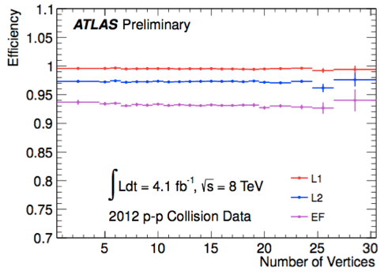
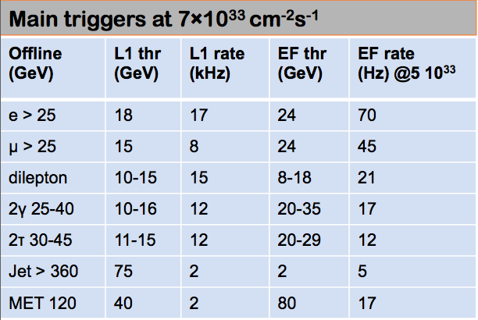
Trigger in 2012
Trigger Menu optimized for 7x10³³cm⁻²s⁻¹ at 8 TeV:
improvement of object selection, e.g. isolation to keep single lepton threshold low (in-spite of 2 x lumi and 2 x pile-up with respect 2011)
pile-up robust algorithms close to offline selections
Operations in 2012 show trigger is coping very well (in terms of rates, efficiencies, robustness,...) with harsh conditions while meeting physics requirements
Trigger rates:
Level 1 rates ~ 65 kHz
Level 2 rates ~ 5 kHz
Event Filter(EF) rates ~ 400 Hz
Efficiency of inclusive single electron trigger as a function of pile-up
PNPI contribution :
E_{T}^{miss} trigger optimization for 2012 data;
optimization of single electron trigger for RUN-II (efficiency and rate) using 2012;

Slide 6
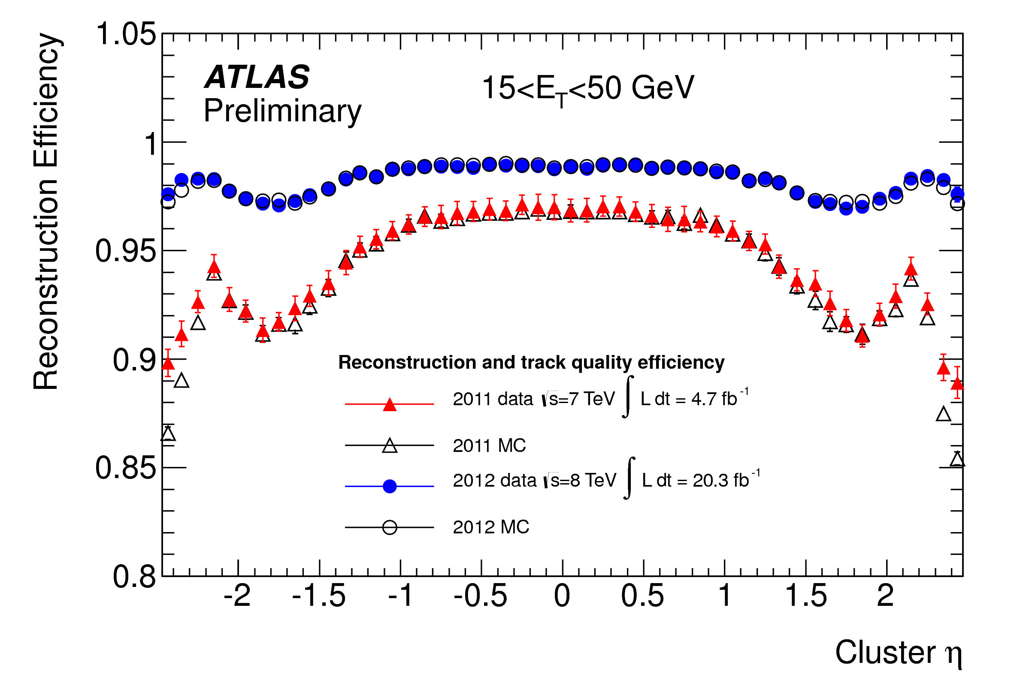
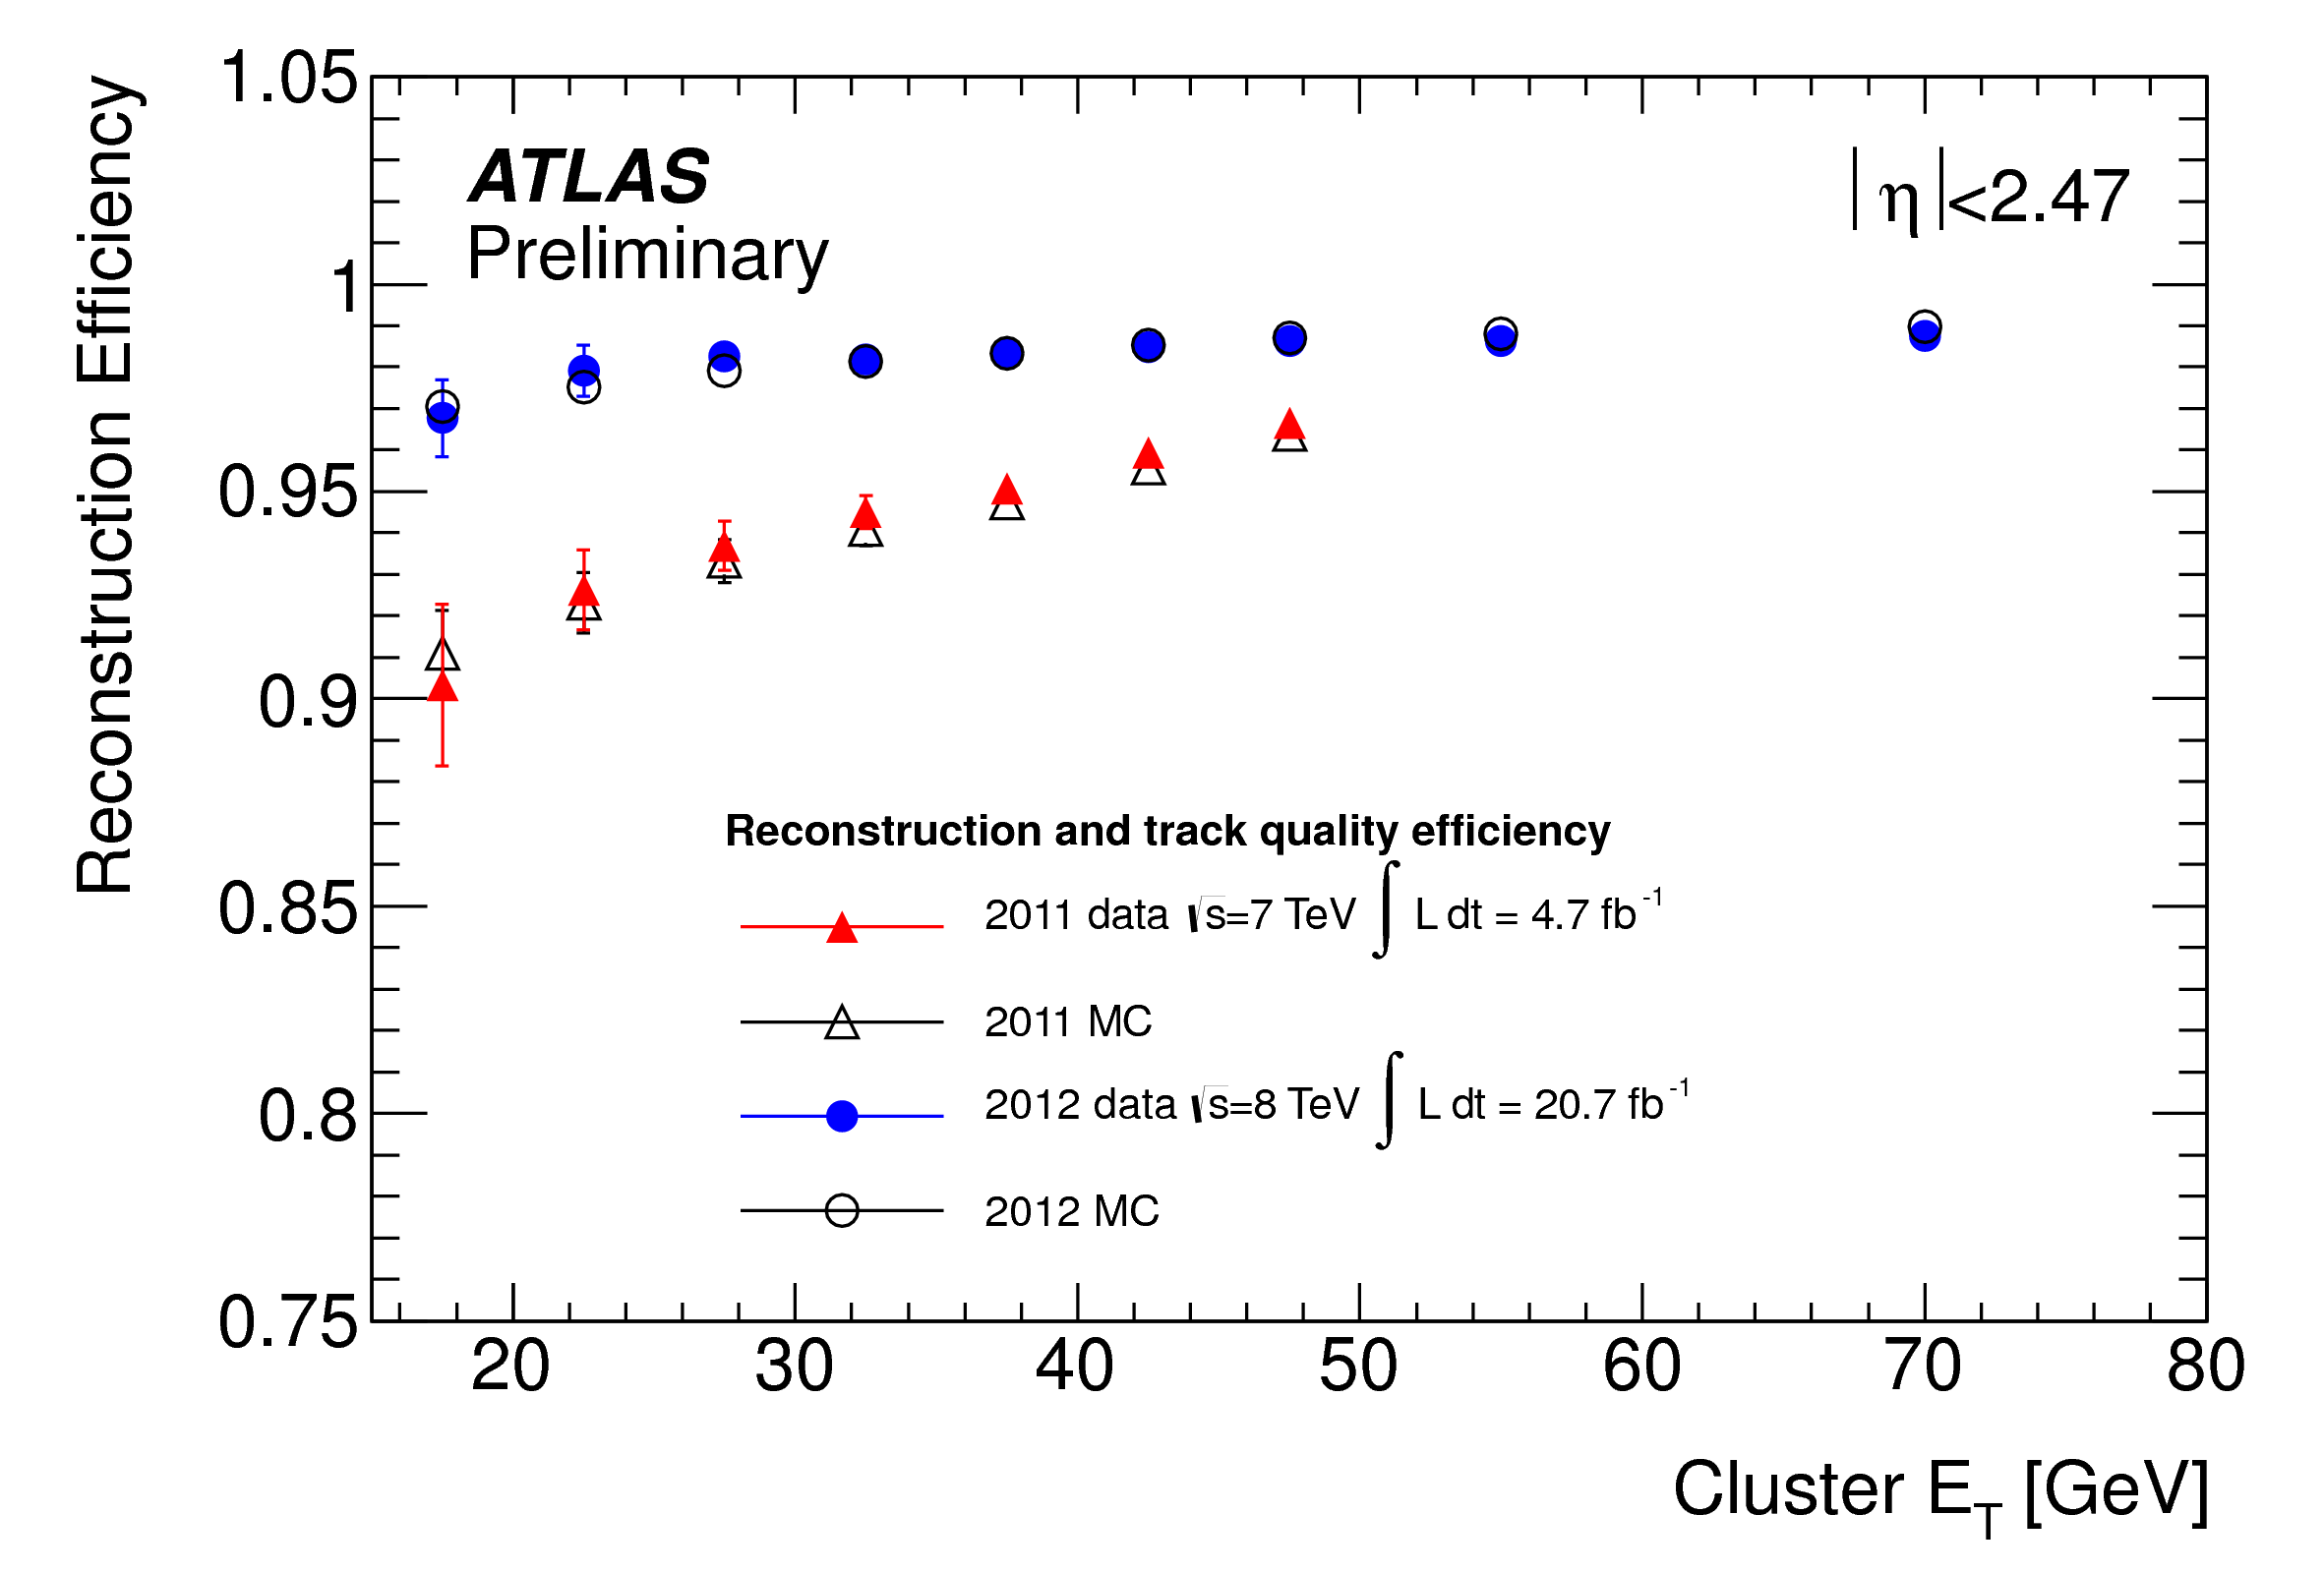
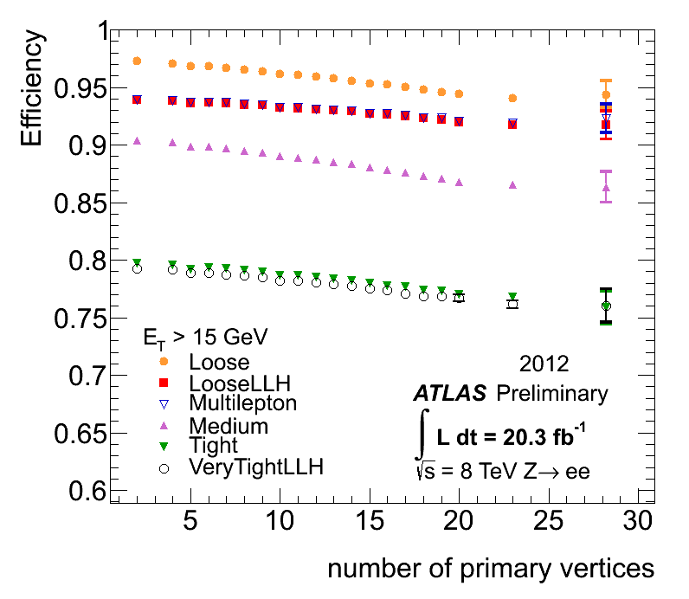
Electron Performance
Results are from Z→ee data and MC tag-and-probe
Electron reconstruction improved
More performing track cluster matching
Track pattern recognition takes in account of bremsstrahlung losses
Achieved ~ 98% reconstruction efficiency, ~ flat vs η and ET
2012
2011
Retuning of cuts (shower shape) Identification efficiency achieved ~ 95%, ~ flat vs pile-up
Electron identification efficiency
2012
2011
PNPI contribution :
s/w development for the tracks refit to account lost of the energy due to brem;
measuring electron efficiencies in 2012 data and define SF in Z→ee and Υ→ee channels;
validation of egamma s/w;
The work supported by RFBR.

Slide 7
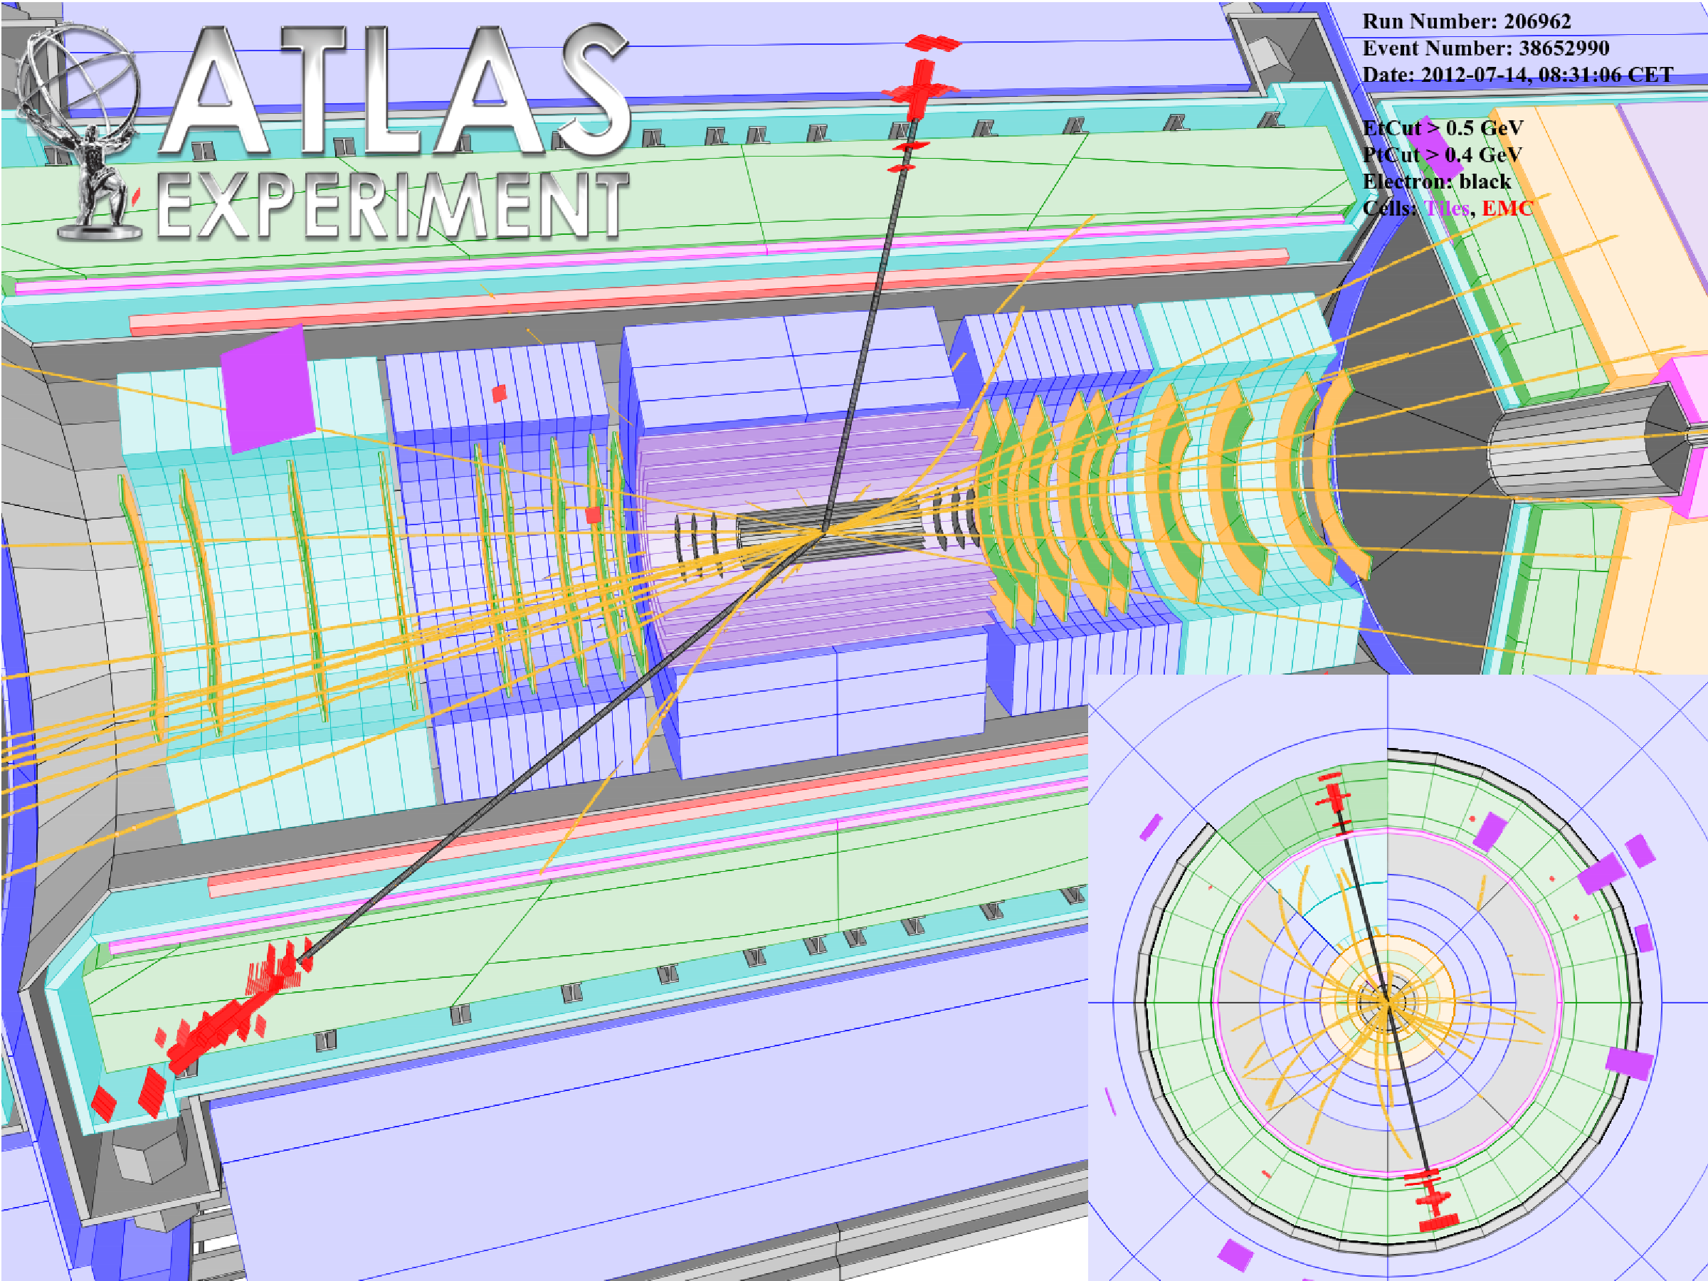
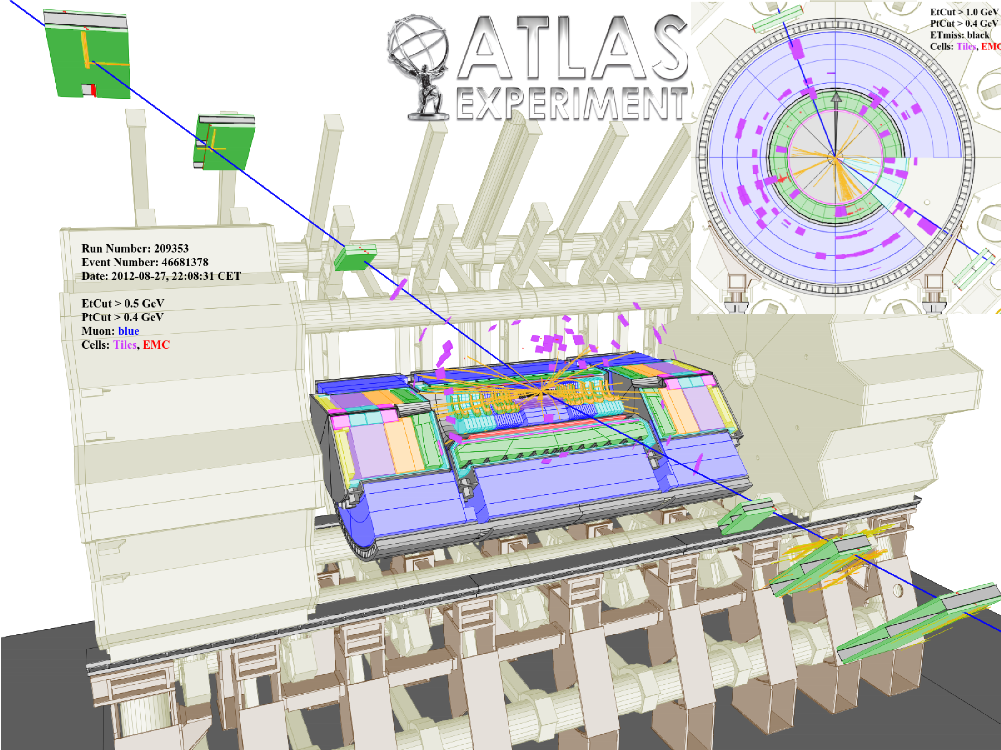
Search for high mass di-lepton resonances
Models: Z’(SSM,E6), Z*, G*(RS) etc
• Signature: l⁺l⁻ (with l=e,μ)
  two electrons |η|<2.47 E_{T} >40/30GeV
  two muons |η|<2.4 E >25 GeV
Benchmark model: Sequential Standard Model (SSM) in which Z’ has the same coupling to fermions as SM Z.
Highest invariant mass dielectron event
m_{ee} =1.5TeV,p_{T}=0.59/0.58 TeV
Highest invariant mass dimuon event
m_{μμ} =1.8TeV,p_{T}=0.65/0.65TeV

Slide 8
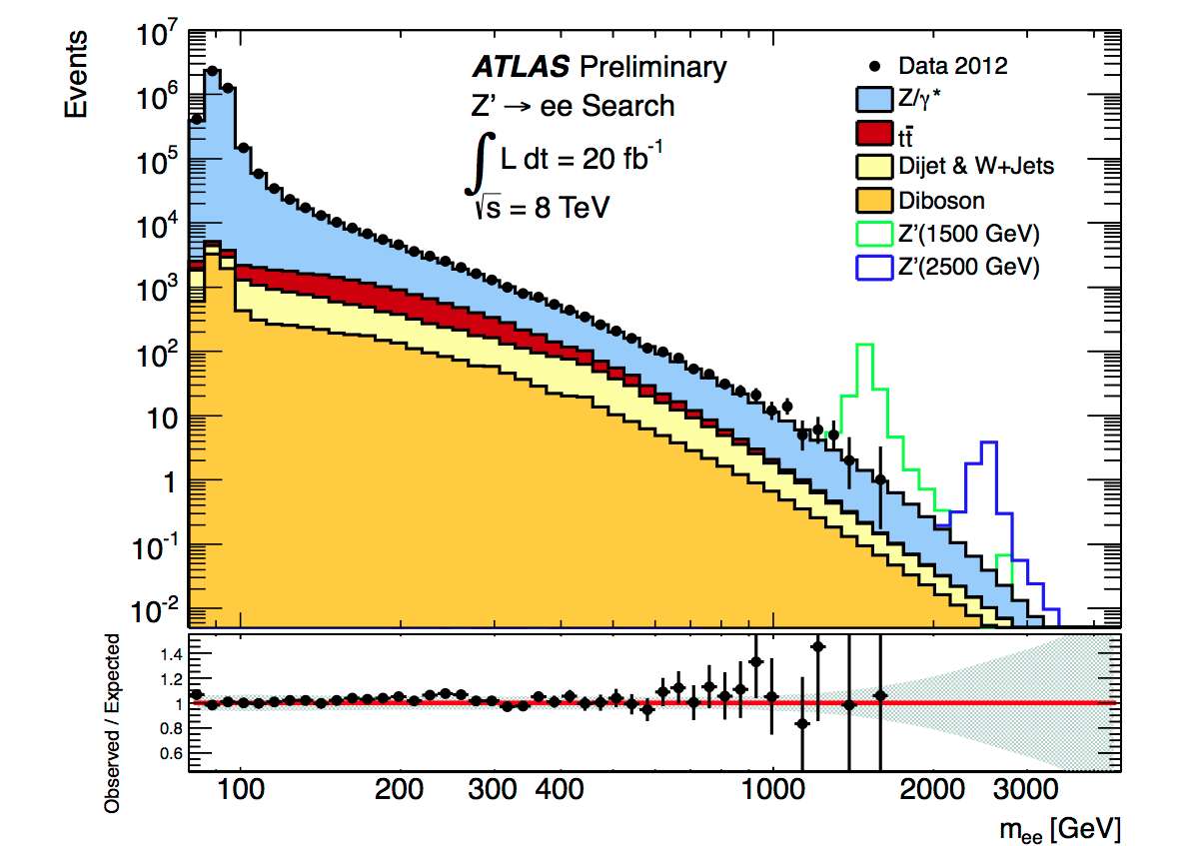
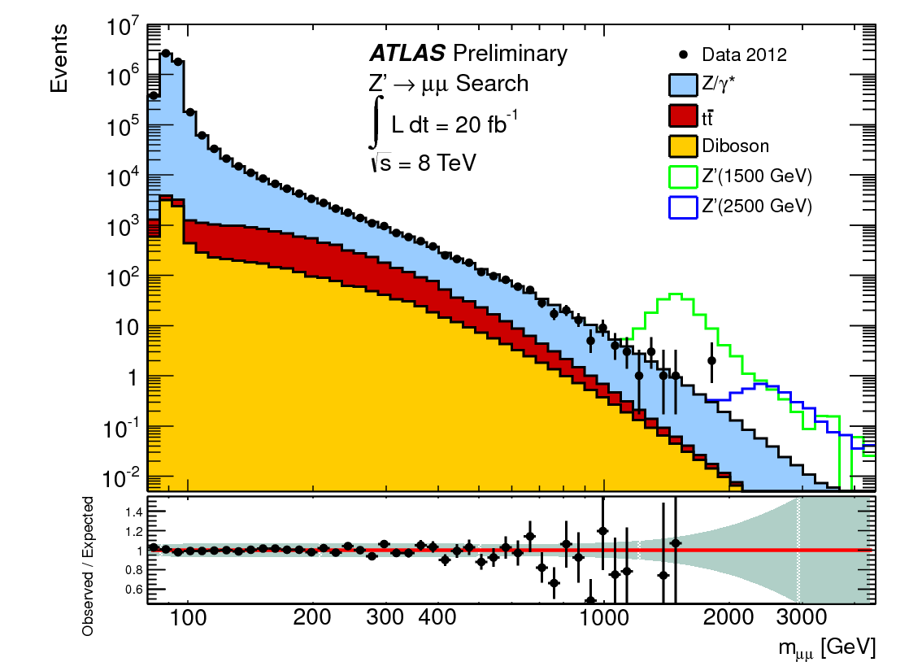
Search for high mass di-lepton resonances
Observable is mass of di-lepton pair normalized to Z-peak
Dominant background is Z/γ*→ ll
Backgrounds:
  From simulation: Drell-Yan, diboson and ttbar
  Data-driven estimation : W+jet and dijet
Signals: From LO simulation

Slide 9

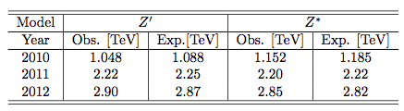

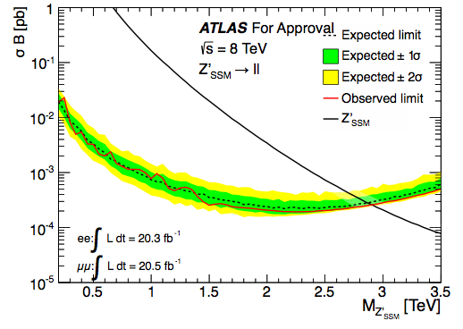
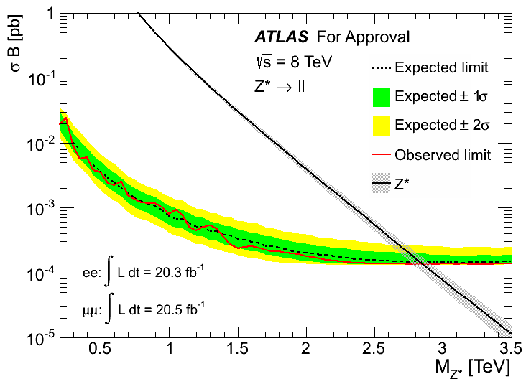
Search for high mass di-lepton resonances
In the absence of any significant signal 95% C.L. limits were set using Bayesian approach on cross section time branching ration
PNPI contribution :
electron channel analysis: cut flow, QCD bkg. estimation, SF for electon efficiencies, Z* MC production and validation, CL for Z* channel.
Z’ (SSM) observed limit: 2.90 TeV
Z* observed limit: 2.85 TeV

Slide 10

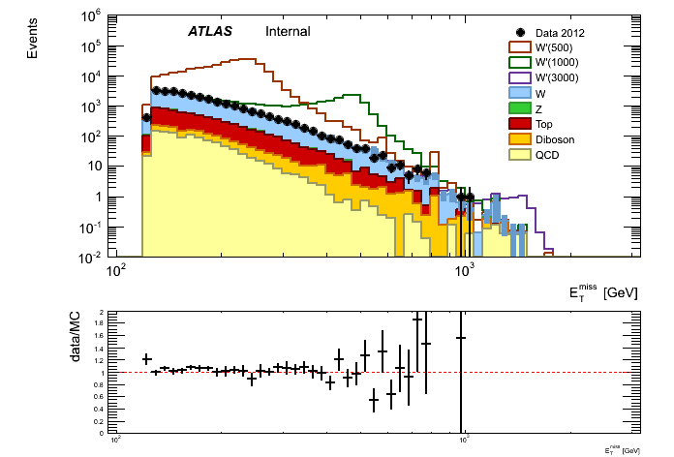
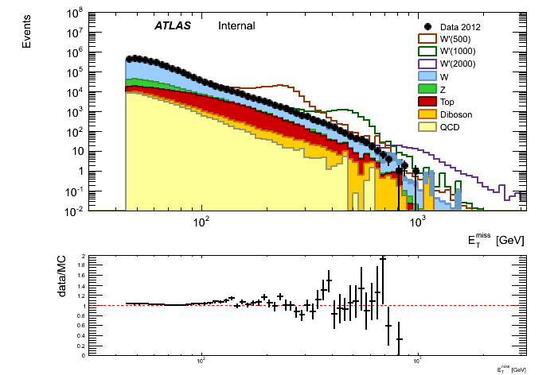
Search for heavy bosons decaying to lepton and neutrino
Many models predict additional heavy bosons that decay to lepton and neutrino
Use Sequential Standard Model (SSM) W’ as benchmark model
Search for high mass states with lepton plus missing ET
The observable is transverse mass
Look for excess above background – counting experiment!!
• Signature: lν (with l=e,μ)
  one electron |η|<2.47 E_{T} >125 GeV and missing E_{T}> 125 GeV
  one muon |η|<2.4 E_{T} >45 GeV and missing E_{T} > 45 GeV
E_{T}^{miss} electrons
E_{t}^{miss} muons

Slide 11
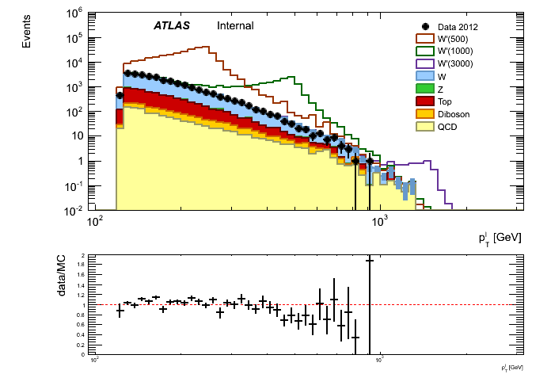
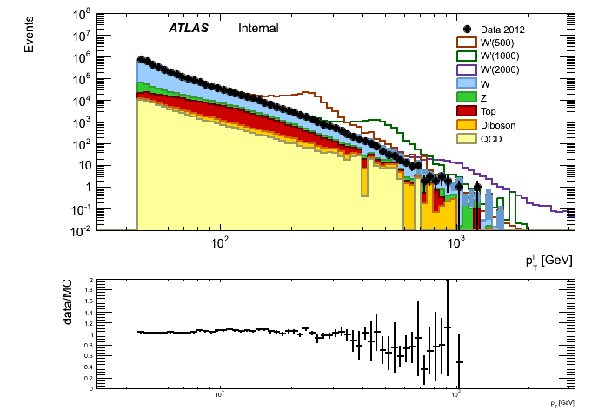
Search for heavy bosons decaying to lepton and neutrino
p_{T} electrons
p_{T} muons
Observed in both channels that MC overestimates data at high p_{T}
Should be resolved to be able to unblind
Background:
W →lν most dominant and irreducible
Z→ll when one lepton is not reconstructed mimicking real missing E_{T}
Dibosons (WW,WZ,ZZ) + ttbar+ single top production are the next largest that have real missing ET
QCD multi-jet estimated from data

Slide 12
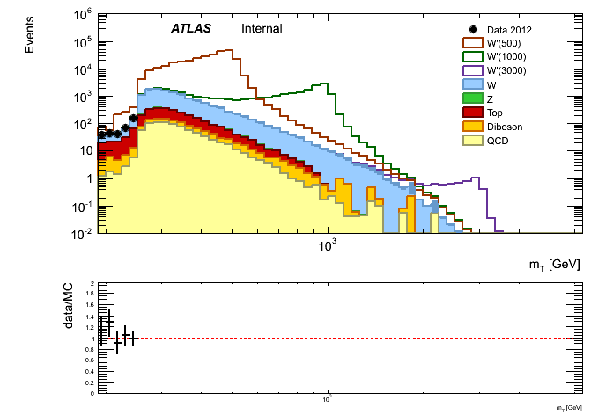
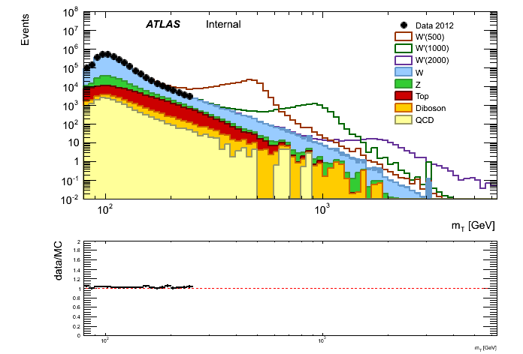
Search for heavy bosons decaying to lepton and neutrino
Analysis is still blind: data above 252 GeV (in the limit setting region) is not shown on plots
m_{T} electrons
m_{T} muons

Slide 13
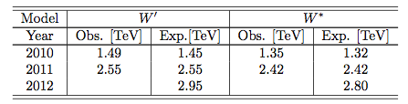
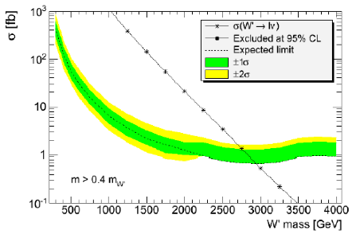
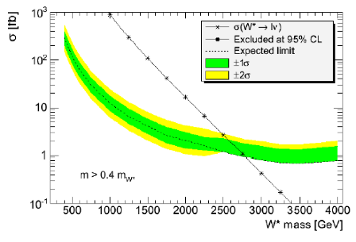
Search for heavy bosons decaying to lepton and neutrino
PNPI contribution :
electron cahnnel analysis: cut flow, QCD bkg. estimation, SF for electon efficiencies, W* MC production and validation, CL for W* channel.
W’ (SSM) expected limit: 2.95 TeV
W* expected limit: 2.80 TeV

Slide 14

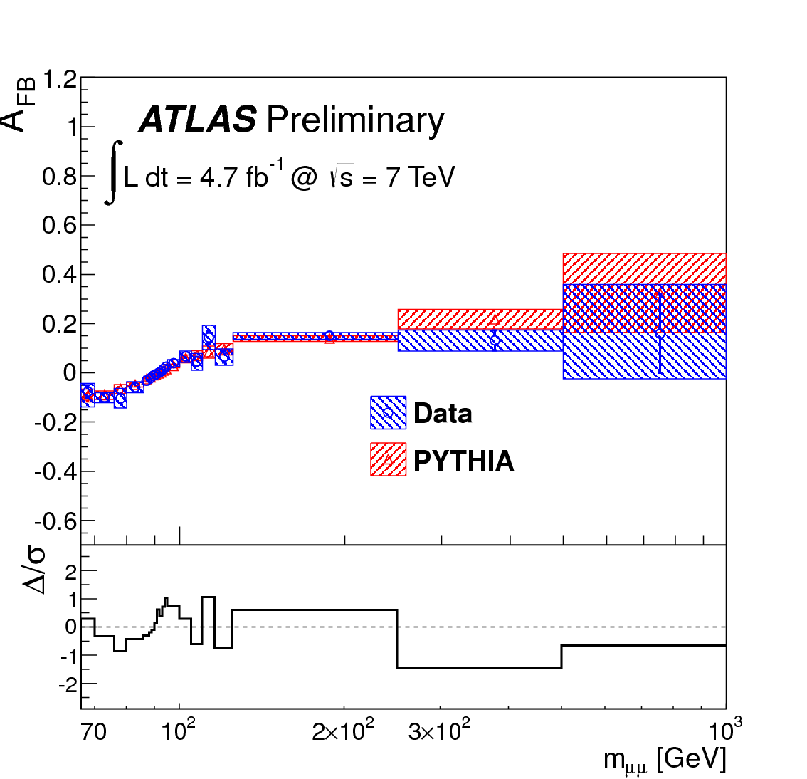

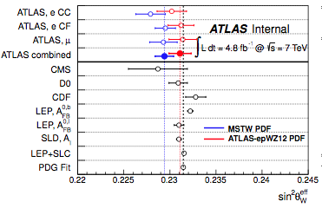

Forward-backward asymmetry in Z→ll
Due to the V-A nature of the electroweak interaction, the leptons produced in the annihilation process qq→ Z/γ*→ l⁺l⁻ present a forward-backward asymmetry (A_{FB}) with respect to the quark direction in the rest frame of the dilepton system.
Several Standard Model parameters can be extracted from the A_{FB} measurement. One of these is the electroweak mixing angle, sin²θ_{W}. At tree level, this is expressed by the ratio of the vector and axial-vector couplings of the fermions

Slide 15
Z-boson polarization
Differential cross-section represented as of nine helicity cross-sections multiplied by harmonic polynomials in θ,φ angles of lepton in the Collins-Soper frame:
LO term
LO term
A3, A4, A5, A6 - parity conserving
A0, A1, A2, A7 - parity violating
A4 - related to AFB
Angular coefficients Ai are functions of lepton-pair kinematics: p_{T}^{ll}, y_{ll}, m_{ll}. Contain information about underlying QCD - dynamics, subject to modifications from higher order perturbative and non-perturbative corrections, structure functions, renormalisation/factorisation scale, underlying event, dependent on the subprocess type: annihilation or Compton scattering. => QCD dynamics can be probed.
Aim is to measure all 8 coefficients A0 -A7, which requires simultaneous 2D fitting in (cosθ_{CS},φ_{CS}) parameter space.
May be used to compare MC generator implementations of hard scatter/parton shower
Not explored in TH papers since almost 20 years, last published results on NLO corrections for Tevatron from `94.

Slide 16
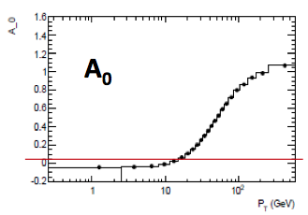
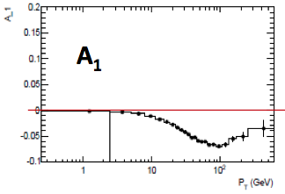
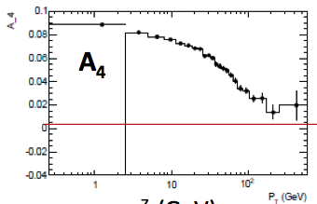
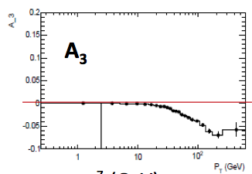
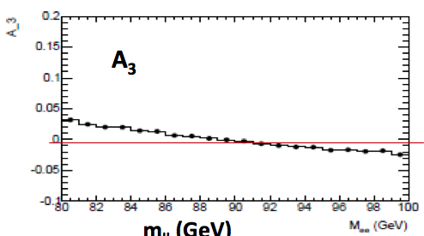
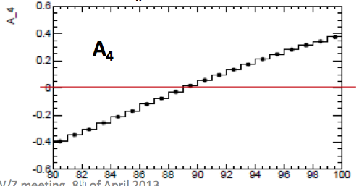
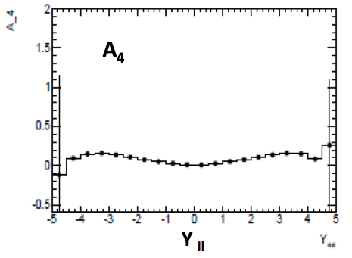
Z-boson polarization
Angular coefficients are not expressed by analytical formulae (usually). Some expected to be small: A1,A3,A4, or close to zero: A5,A6,A7. At large p_{T}, A0 and A2 grow and saturate at 1.
Only A3 and A4 show some dependence on m_{ll} and Y_{ll} .

Slide 17
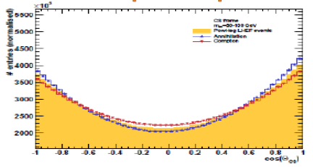
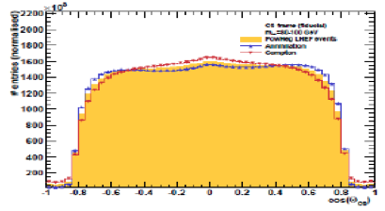
Z-boson polarization: analysis strategy
Standard data analysis in the fiducial volume, after background subtraction and unfolded to the particle level (from detector effects and QED FSR: use Born-level leptons).
Monte Carlo templates (particle level) propagated to the fiducial volume; use reweighting to isotropic events.
2D fit in (cosθ_{CS},φ_{CS}) distributions in p_{T} bins, coefficients A0-A7 extracted from the fits.
Comparison of measured coefficients with different MC predictions and different PDFs.
  Interpretation in language of QCD dynamics.
  Relation between A4 and sin²θ_{W}.
Prediction power for other observables (e.g. φ*) At this point, we have a handle (in principle) on infinite order QCD in Collins-Soper frame!
full phase-space
fiducial phase-space
Distributions are sensitive to the production sub-process, and the shapes change rapidly with p_{T}^{Z}. In fiducial volume, the shapes are dominated by kinematic effects

Slide 18
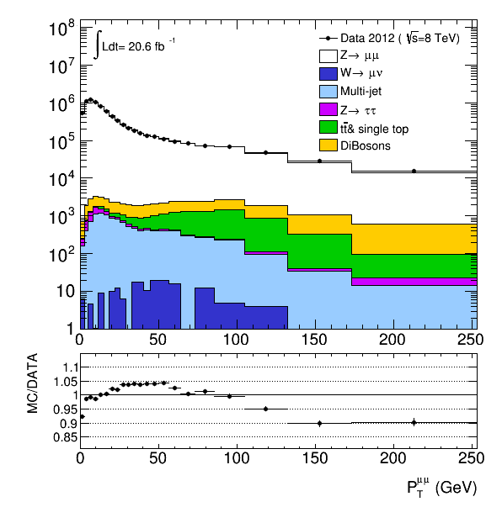
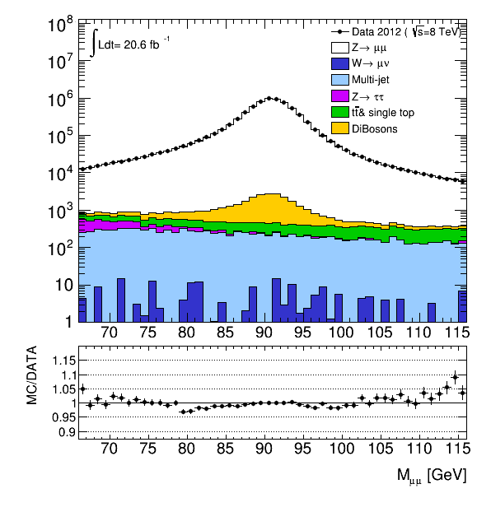
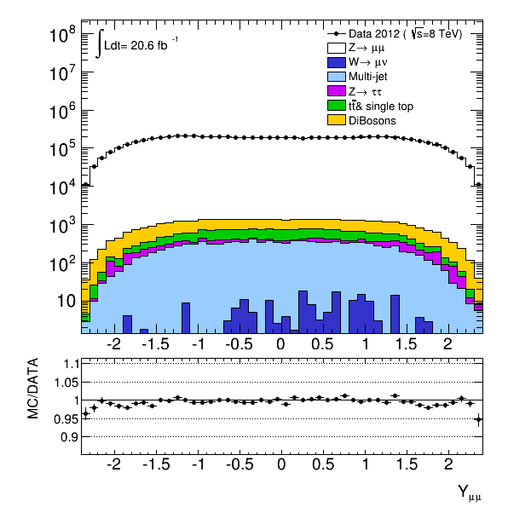
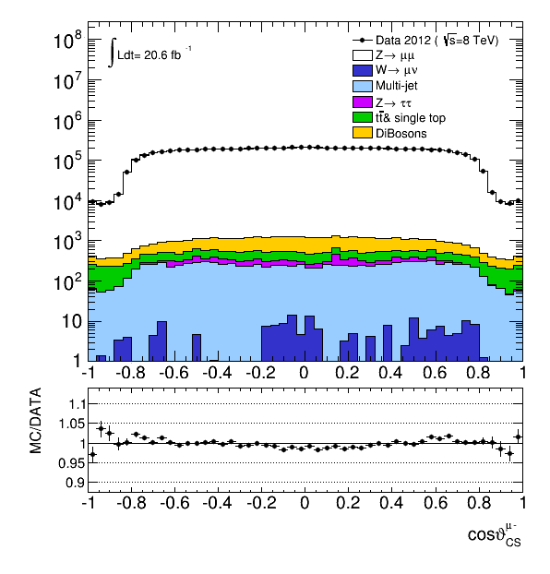
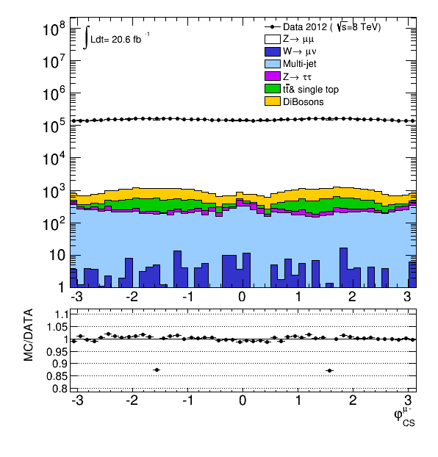
Z-boson polarization: QCD background estimation
PNPI contribution :
muon channel analysis: cut flow, QCD bkg. estimation, unfolding, closure for unfolding, reweightnig reco to data, template from different MC and fit in 2D space to extract coefficients

Slide 19
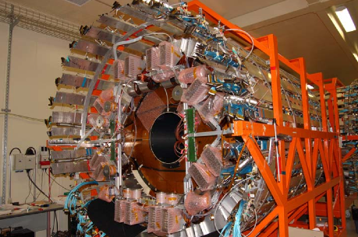
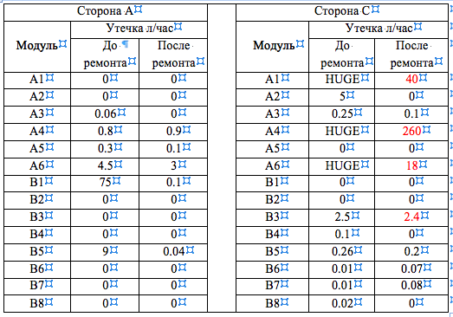
TRT detector
Фотография одной из трубок для подачи газовой смеси в детектор TRT, сделанная с помощью эндоскопа, на которой видно ее повреждения в месте изгиба под воздействием озона.
TR ratio vs # run
PNPI contribution :
repairing of TRT detector;
TRT s/w development

Slide 20
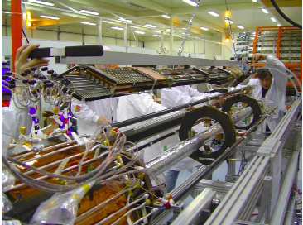
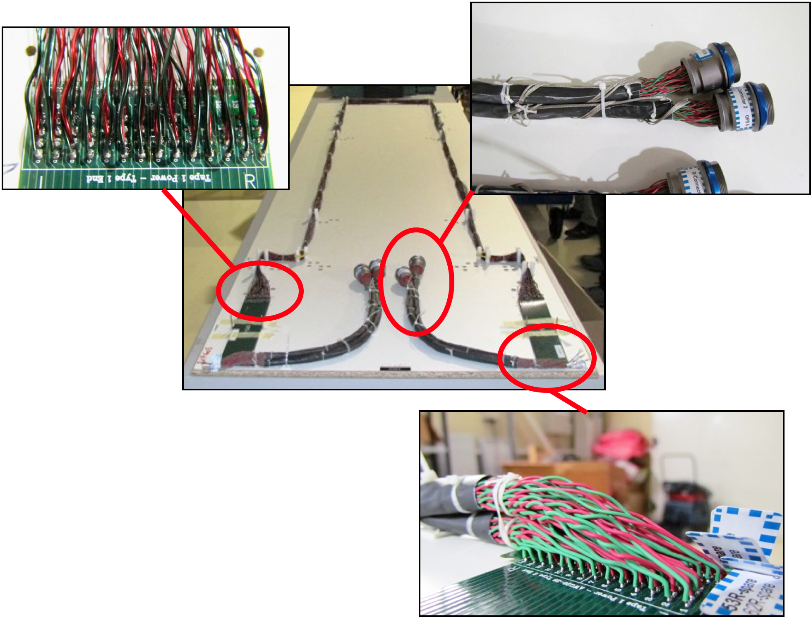
Pixel New Service Quarter Panels (nSQP) and IBL
Transfer services from outside world to pixel detectors
Problematic opto-couplers on SQP
To replace these need new infrastructure and electronics
New electronics will allow greater readout bandwidth for > 10³⁴ operation
PNPI contribution :
creation and assembly cables for the nSQP (technicians and engineers);
installation of cables and temperature sensors for the Pixel evaporative cooling systev
s/w developing for the Pixel DCS.

Slide 21
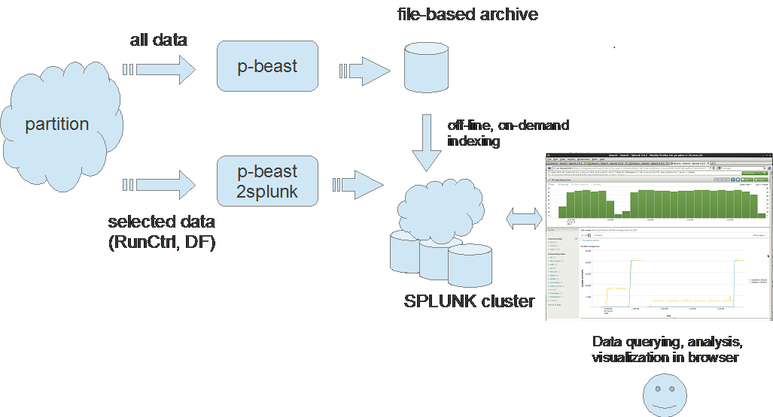
TDAQ/DCS
PNPI contribution to TDAQ:
Отдел информационных технологий проф. Рябов Ю.Ф.
Software development of the system of control, configuration and monitoring of ATLAS DAQ – 4 new versions have been issued.
Improvement of web interface of the “Shifter Assistant” system for the expert support of operational control of DAQ and detectors.
Development of new tools of archiving and graphical representation of operational monitoring information.
PNPI contribution to DCS:
  Upgrade computers, operating systems and base SCADA system of central DCS (11 PC)
  Development, testing and put in production of new CANOpen OPC server in advanced standard OPC UA.
  Upgrade and improvements of:
        Rack Control system,
        DCS Access Control (including remote access),
        ATLAS – LHC Communication
        Interface to Condition Database
        Calorimeters’ Cooling package
      DCS Expert on-call (7/7,24/24) > 20 weeks.
Scheme of archiving & representation of data of TDAQ operational monitoring

Slide 22
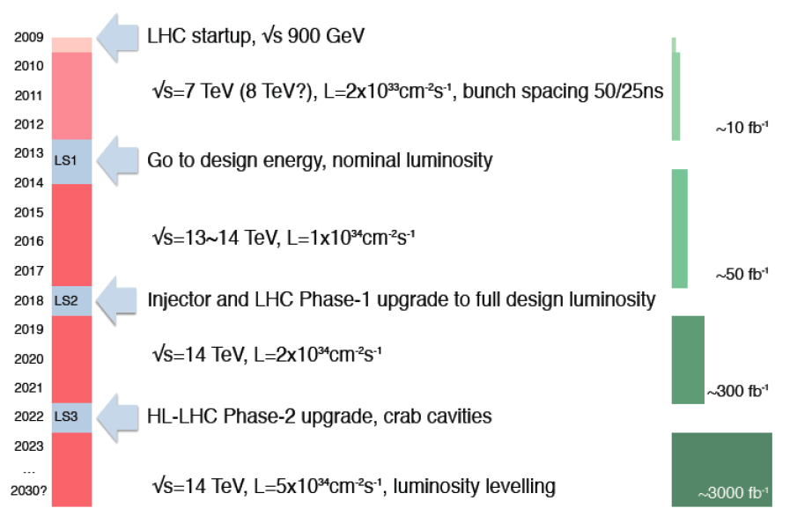
План модернизации (upgrade) LHC
LHC startup, √s = 900 GeV
4x
, bunch spacing 50 ns
√s=7~8 TeV, L=6x10³³ cm⁻² s⁻¹, bunch spacing 50 ns
Peak luminosity observed in ATLAS in 2012 - 7.7 10³³ cm²s⁻¹
~20-25 fb⁻¹
Go to design energy, nominal luminosity
√ s=13~14 TeV, L~1x10³⁴ cm⁻² s⁻¹, bunch spacing 25 ns
, bunch spacing 25 ns
~75-100 fb⁻¹
Injector and LHC Phase-1 upgrade to ultimate design luminosity
√ s=14 TeV, L~2x10³⁴ cm⁻² s⁻¹, bunch spacing 25 ns
, bunch spacing 25 ns
~350 fb⁻¹
HL-LHC Phase-2 upgrade, IR, crab cavities?
?, IR
√ s=14 TeV, L=5x10³⁴ cm⁻² s⁻¹, luminosity leveling
Towards to High Energy LHC (HE-LHC) -√s=33 TeV

Slide 23
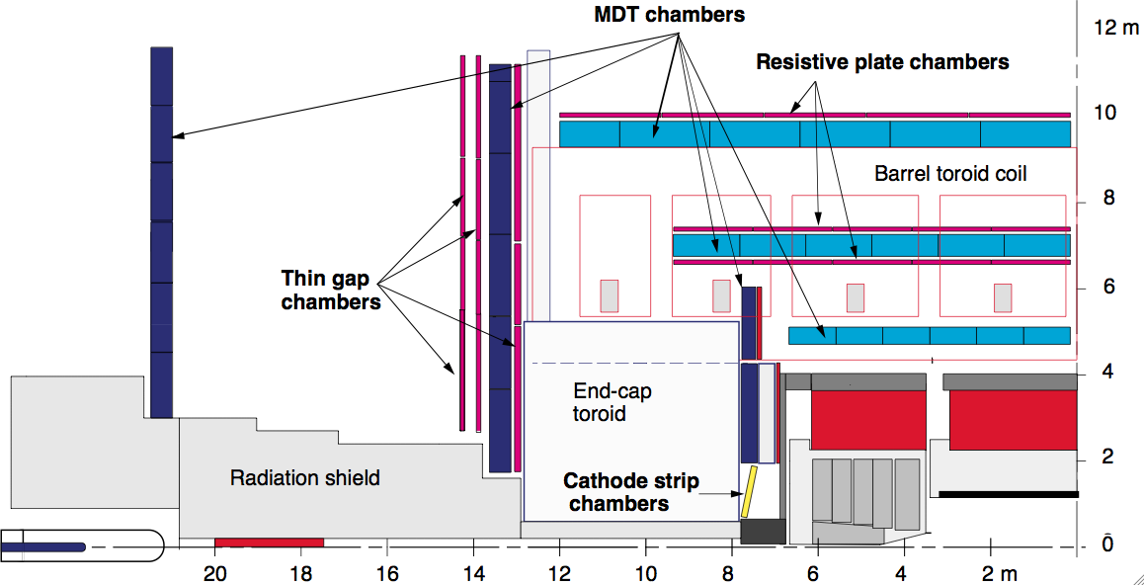

PNPI @ ATLAS upgrade – Phase I
Новые детекторы в NSW должны:
выдерживать загрузки до 15 кГц/см²
On-line (триггер)
  Эффективность 99%
  Обеспечить набор измерений с точностями R~100 мкм, φ~2-3 мрад, dθ~1 мрад;
Off-line реконструкция
  обеспечивать трековое разрешение ≈60 мкм в плоскости R-φ;
  угловое разрешение ≈0.3 мрад;
  эффективность восстановления сегмента трека не хуже 97%;
  сохранять работоспособность до 1 К/см² накопленной дозы облучения (предполагая 10 лет работы в условиях sLHC).
В качестве новых детекторов были выбраны:
TGC камеры хорошо, зарекомендовавшие себя в эксперименте ATLAS;
новая технология MM (Micro Megas).
Possible participation of PNPI :
Construction and assembly of sTGC chambers.
Development of fast simulation for nSMW;
Development trigger s/w and h/w for nSMW.

